Slide 1
STAINED GLASS

Slide 2
Art that is always changing because of the effect of different light shining through
Made with big sheets of blown glass that has color because of different metallic oxides
Oxide – oxygen reacting with another element such as:
Cobalt to make blue

Slide 3
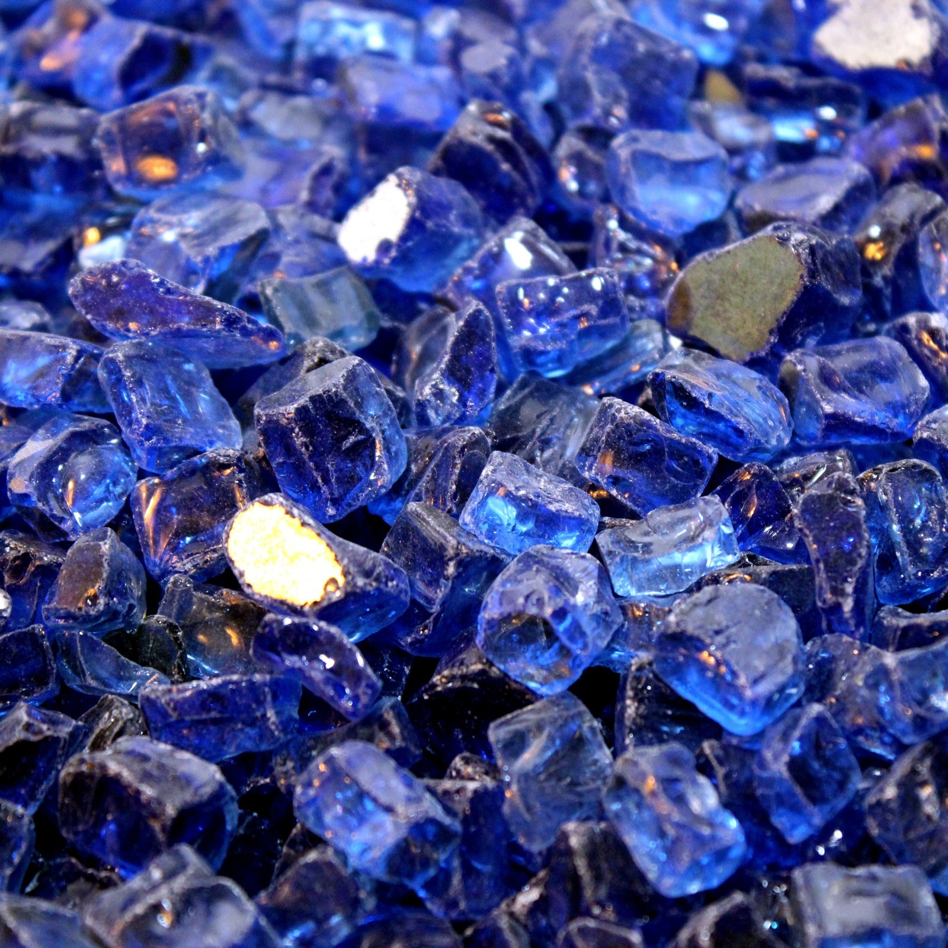
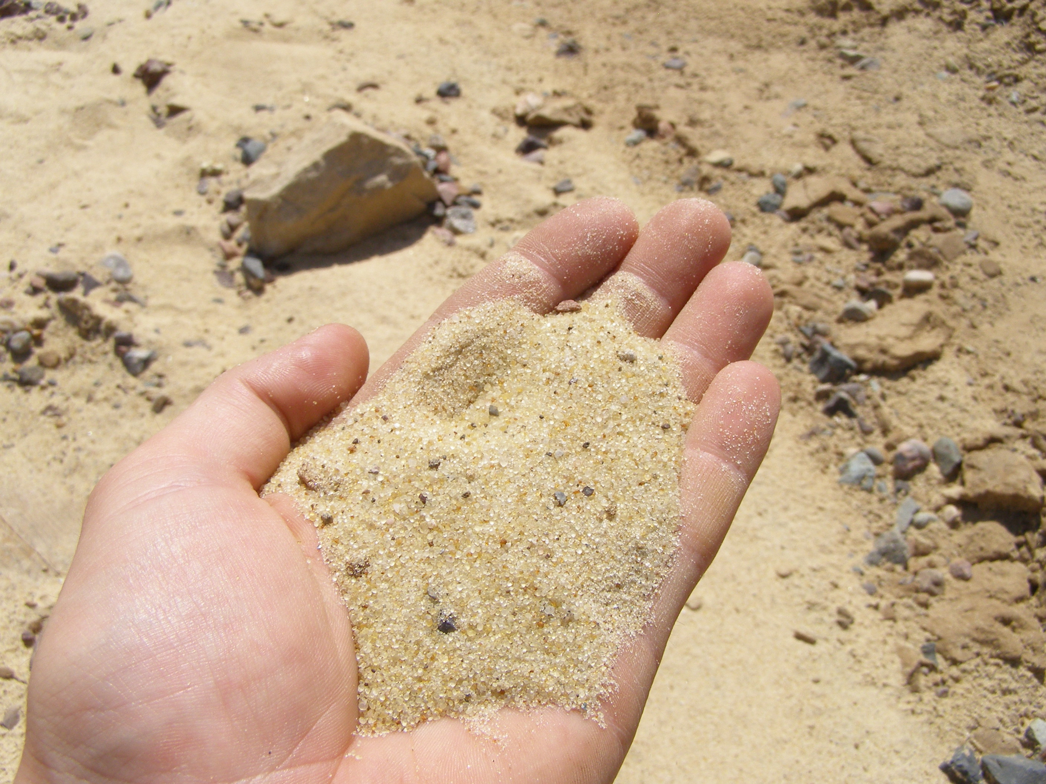
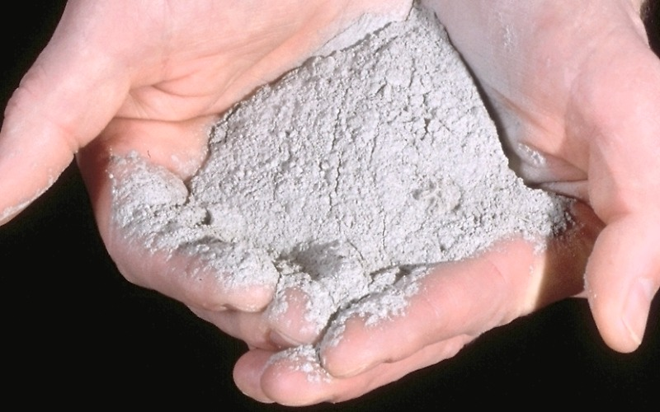
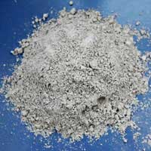
Ash
Cobalt Oxide
Sand
High Temperatures
Lime
COLORED GLASS!

Slide 4
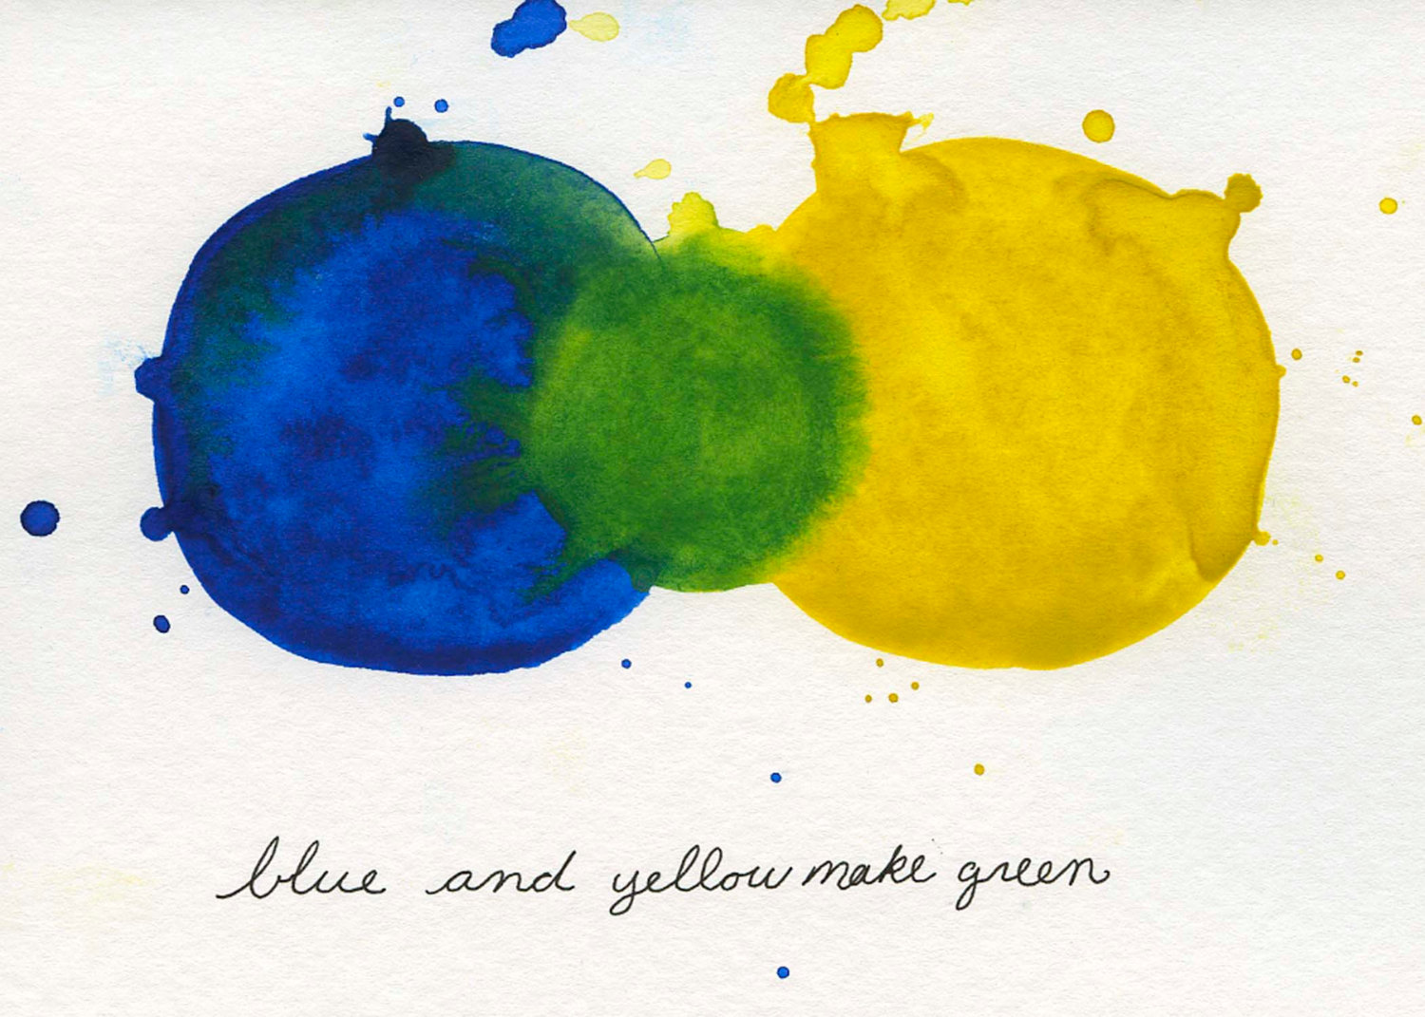
More colors can be made by layering the colored glass

Slide 5
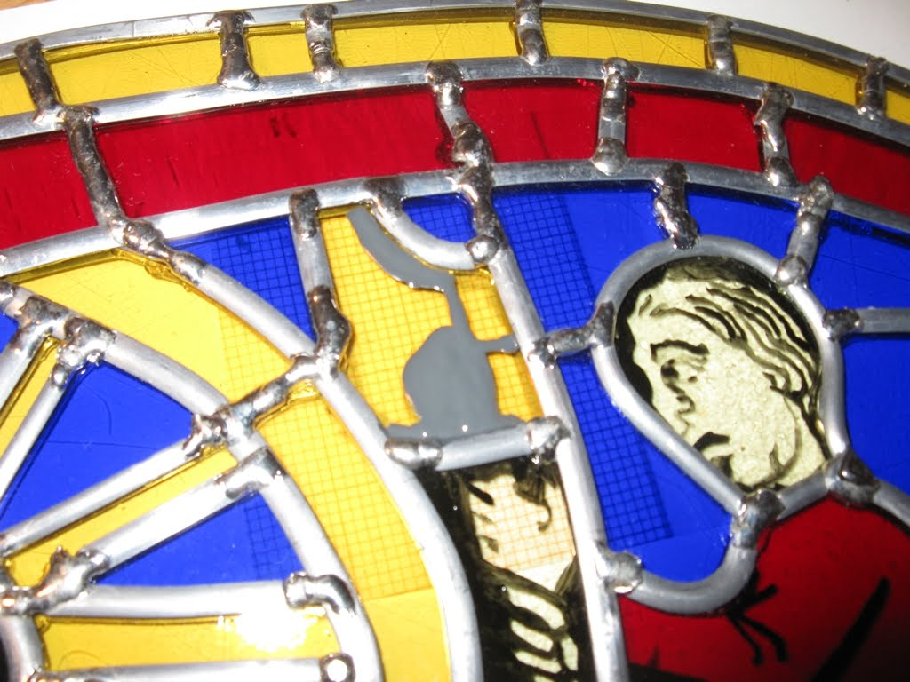
The big pieces of glass are joined together with lead stripes called cames.

Slide 6
Gothic Cathedral Stained Glass
Chartres Cathedral
1150 – 1250 (almost 1,000 years old!)
One of few French Cathedrals with surviving stained glass windows
Rose Window

Slide 7
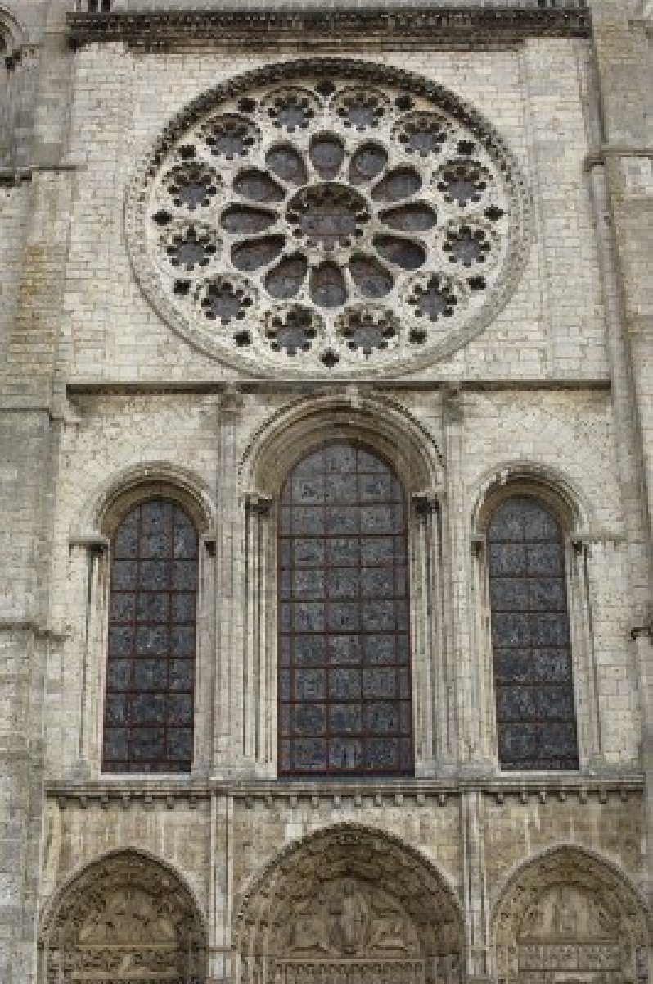

Slide 8
Rose Window

Slide 9
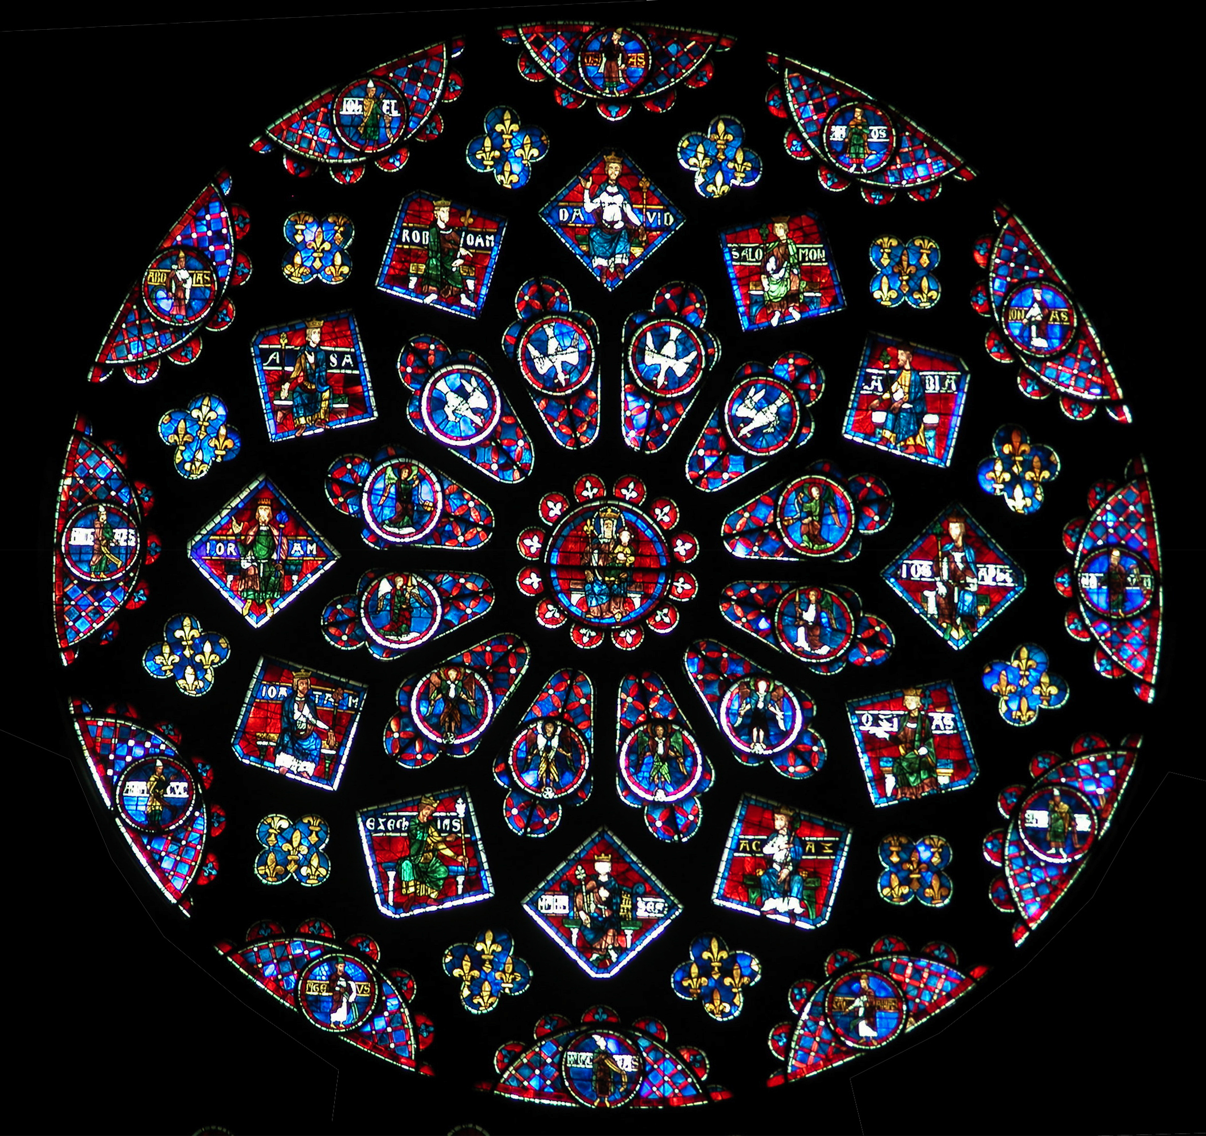

Slide 11
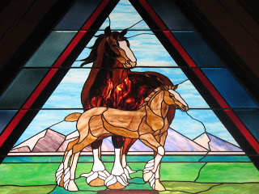

Slide 15
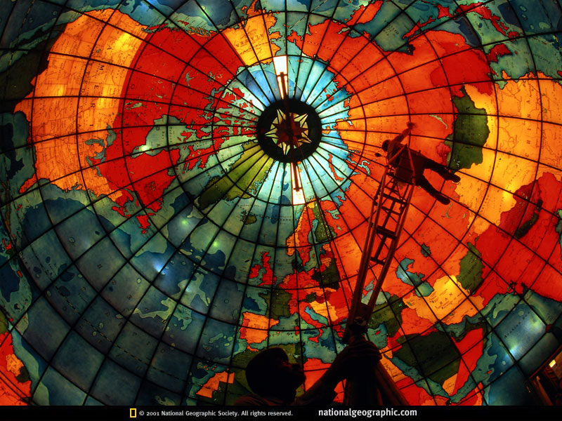

Slide 16
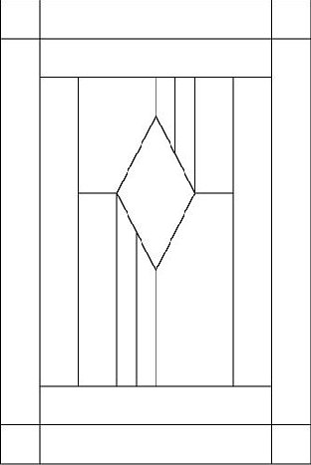

Slide 17
Layer your tissue paper to make more colors like colored glass is layered!
Be careful! The tissue paper is fragile and may tear like glass is fragile and may break!

